Slide 1
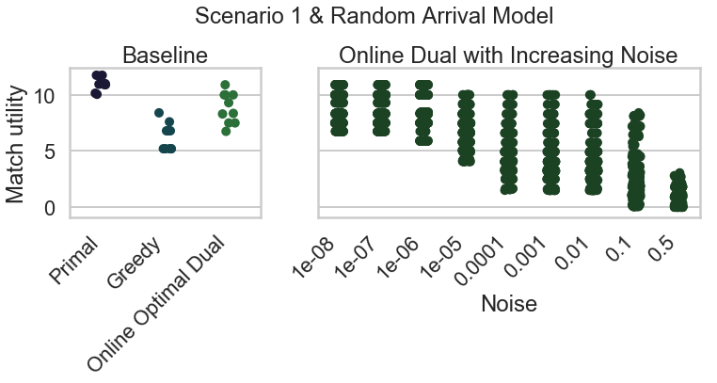
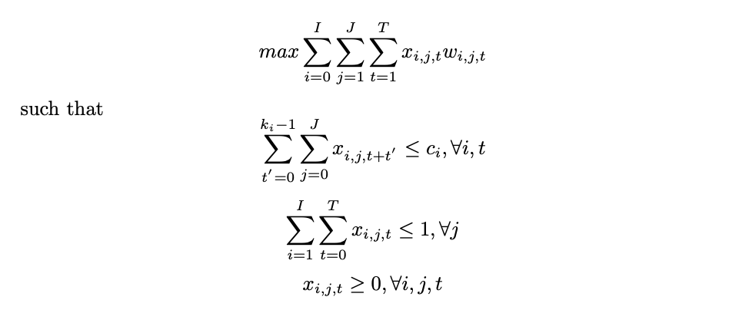
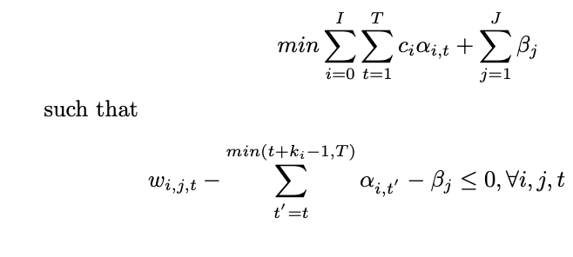
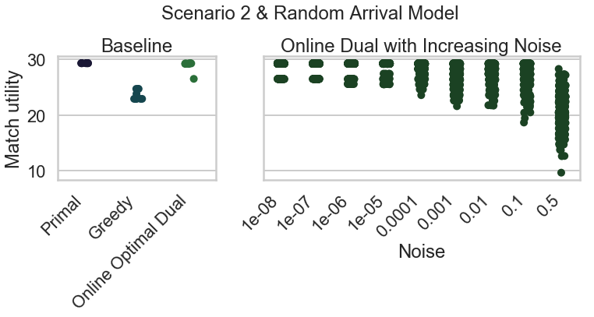
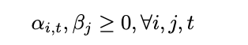
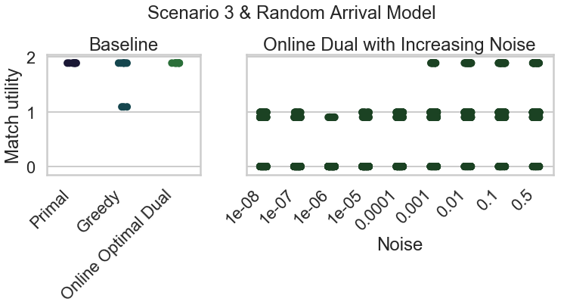
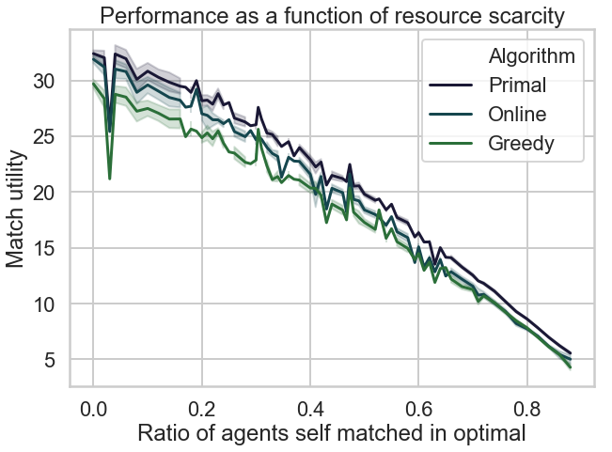


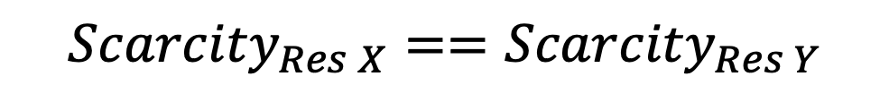







Dynamic Matching Algorithms for Homelessness Reduction
Luke Guerdan¹, Chien-Ju Ho², & Sanmay Das²
Dept. of EECS, University of Missouri-Columbia¹ CSE Dept., Washington University in St. Louis²
At the end of each trial, the correct category was revealed and the subjects recorded the accuracy of their category guess.
Introduction
Problem Formulation
Stress Tests & Failure Cases
Finding optimal homelessness intervention allocations is complicated by dynamic arrivals and departures of homeless agents¹. Primal-dual techniques have been used in online allocation contexts previously, and could address this problem².
Primal Formulation
$∈\left\{0,1\right\}.$Binary match variable
Dual Formulation
Scenario 1
 | Agent A | Agent B
Resource X | .05 | .05
Resource Y | .1 | .9
$∈ℜ. M$atch quality
s.$t.$
$${Scarcity}_{Res X} ≪{Scarcity}_{Res Y}$$
This work aims to develop an online primal-dual based dynamic matching strategy for pairing homeless agents with interventions.
$$s.t.$$
Scenario 2
 | Agent A | Agent B
Resource X | .99 | .99
Resource Y | .05 | .95
The Housing Assignment Problem
Dual: Resource use over time
Dual: Agent quality
$${Scarcity}_{Res X}=={Scarcity}_{Res Y}$$
Homelessness Intervention
i=0
Scenario 3
i=1
Directly solving the primal is infeasible since we don’t know future arrivals.
Using strong duality and complementary slackness, if we are given an optimal dual, we can devise an online assignment algorithm.
 | Agent A | Agent B
Resource X | .05 | .05
Resource Y | .05 | .95
i=2
j=1
Without knowing about future agents, which current agents should be matched with an intervention?
1 copy of resource X & Y
Agent
j=2
Online Dual-Based Assignment
j=3
t=0
t=1
t=T
Offline Primal
Time
For each non-matched, available agent in each round, allocate to:
Future arrival
Present arrival
Each intervention has:
$\underset{i}{i^{∗}=max}{\{}$ } (if $i^{∗}$=0, don’t consider agent matched)
Discussion
Utility = .32
A use duration
Potentially multiple copies
A match utility with each arriving agent
Online dual-based matching yields a more-optimal pairing of homeless agents compared with greedy matching. This is particularly pronounced in situations where greedy assignment fails to consider future information and dual noise is limited.
Utility = .91
Dual-based vs. Greedy Matching
Online dual-based (with optimal dual) out-performs greedy matching, especially when resources are abundant..
In practice, it is unlikely to obtain an optimal dual. We next investigate how dual noise deteriorates performance.
Next steps will investigate simulation and machine learning
methods for learning dual variables without oracle knowledge.
Linear Programming
X₁
Goal: optimize a linear objective function subject to linear equality and inequality constraints.
References
Primal
Dual
Kube, A., Das, S., & Fowler, P. J. (in press). Allocating interventions based on counterfactual predictions: A case study on homelessness services. In Proceedings of the Association for the Advancement of Artificial Intelligence (AAAI)
Li, Z., Lieberman, K., Macke, W., Carrillo, S., Ho, C., Wellen, J., & Das, S. (2019). Incorporating Compatible Pairs in Kidney Exchange. Proceedings of the 2019 ACM Conference on Economics and Computation - EC 19. doi:10.1145/3328526.3329619
$$min c^{T}x$$
$$s.t. Ax≥b$$
$$and x ≥0$$
Any primal lp has an equivalent dual
$$max b^{T}y$$
$$s.t.{ A}^{T}y≤c$$
$$and y ≥0$$
Feasible region
This research was funded by a NSF REU grant (award #1852343), and the Washington University Interdisciplinary Seed Grant Program.
Feasible region
Where $x$ is a decision variable, and $y$ is a linear combination of primal constraints (dual variable).
X₂
Intervention scarcity
lmg4n8@mail.missouri.edu
Notes:
Behavioral results: make bar graphs of RT?
fMRI results: labels, figure caption, make blues in graph the same color
References: add marcel 2004, add numbers, rearrange

